Slide 1
OpenMP GPU
Computer Division
Bhabha Atomic Research Centre

Slide 2
Topics
Computing with Accelerators
Heterogeneous Computing
OpenMP GPU
Development Cycle
Directives
Data Mapping
NVIDIA HPC SDK
Vector Addition Example

Slide 3
Computing with Accelerators
CPU | OpenMP | MPI |  | OpenACC | OpenCL
GPU | OpenMP |  | CUDA | OpenACC | OpenCL
DSP |  |  |  | OpenACC | OpenCL
FPGA |  |  |  | OpenACC | OpenCL

Slide 4
Software for Heterogenous Computing
Low Level APIs
CUDA: Specific to Nvidia GPUs
OpenCL: All Accelerators supported, even FPGA
Both are openly available, but one needs to learn new syntax for writing and calling kernel functions
High Level APIs (requires compiler support)
OpenACC: Compiler directive based, user friendly, similar to OpenMP
OpenMP: Ver 4.0 onwards has support for heterogenous archs
Compilers
NVCC and CRAY compilers provide support for OpenACC
Intel Compilers provide support through OpenMP

Slide 5
Heterogeneous Computing
Libraries
cuBLAS, cuFFT, CUDA Math
Directive based
OpenACC, OpenMP
Programming languages
CUDA – NVIDIA
OpenCL – NVIDIA, ATI, FPGA

Slide 6
OpenMP GPU – Introduction
Supported by
GCC, and NVIDIA
Incremental
Single Source
Low Learning Curve

Slide 7
OpenMP GPU – Incremental
Maintain existing sequential code
Add annotations to expose parallelism
Verify correctness
Annotate more code

Slide 8
OpenMP GPU – Incremental
Working sequential code
Parallelization with OpenMP GPU
Verify correctness
Compute performance
/// Sequential code
for( i=0; i <N; i++)
{
c[i] = a[i] + b[i]
}
/// OpenMP GPU code
#pragma omp target teams distribute parallel for
for( i=0; i <N; i++)
{
c[i] = a[i] + b[i]
}

Slide 9
OpenMP GPU – Single Source
Rebuild same code – Multiple architectures
Compiler based parallelization – Desired machine
Maintained sequential code

Slide 10
OpenMP GPU – Single Source
Supported platforms
NVIDIA GPU, and AMD GPU
Optional OpenMP GPU code additions
Same code for parallel or sequential execution
/// Sequential code
#pragma omp target teams distribute parallel for
for( i=0; i <N; i++)
{
c[i] = a[i] + b[i]
}
/// nvc++ -mp=multicore main.c
/// OpenMP GPU code
#pragma omp target teams distribute parallel for
for( i=0; i <N; i++)
{
c[i] = a[i] + b[i]
}
/// nvc++ -mp=gpu main.c

Slide 11
OpenMP GPU – Low Learning Curve
Easy to use
Easy to learn
Programming languages – C, C++, or Fortran
No need to learn low level hardware details

Slide 12
OpenMP GPU – Low Learning Curve
Hints to compiler
Parallelization by compiler
int main(int argc, char *[] argv)
{
/// Sequential code
#pragma omp target teams distribute parallel for
for( i=0; i <N; i++)
{
/// Parallel code
}
}

Slide 13
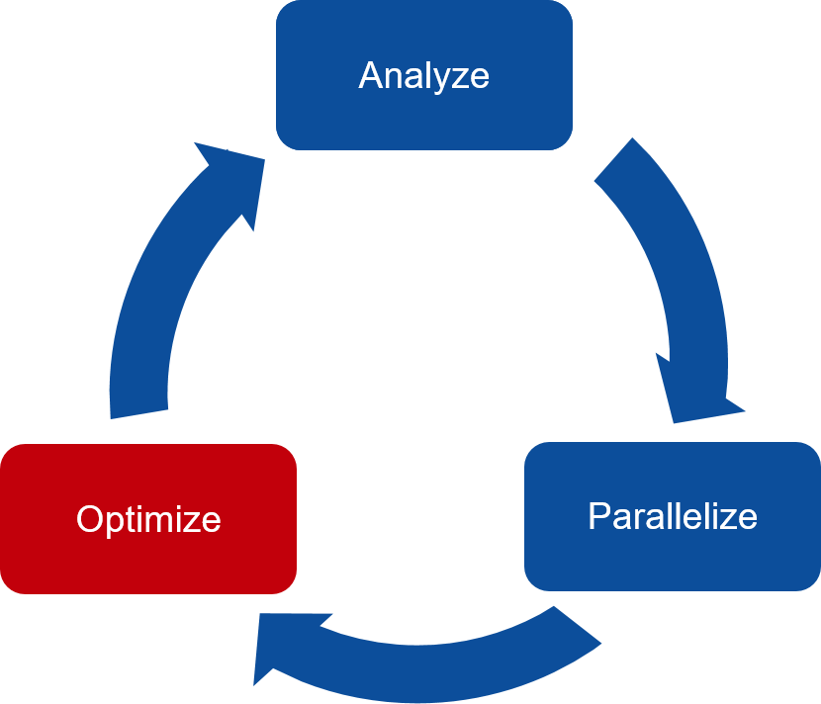
OpenMP GPU – Development Cycle
Analyze
Identify code region for parallelization
Parallelize
Parallelize most time consuming part
Check for correctness
Optimize
Improve speed-up

Slide 14
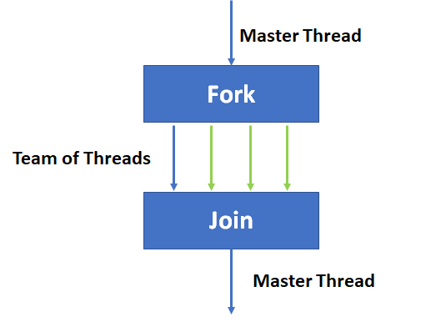
OpenMP GPU – Fork Join Model
Fork Join Model
Master thread
Team of threads
Team of parallel threads
Execute in parallel
Join threads
Continue master thread

Slide 15
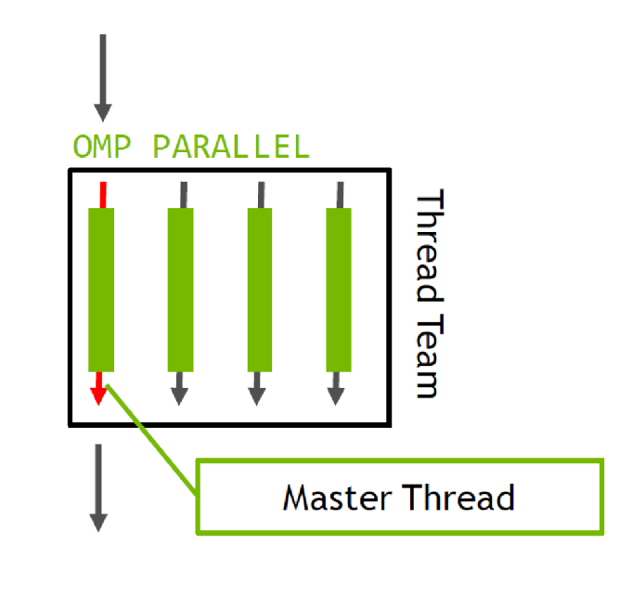
OpenMP GPU Directives
#pragma omp parallel
Master thread
Create team of threads
Execute in parallel
Join threads
Continue master thread

Slide 16
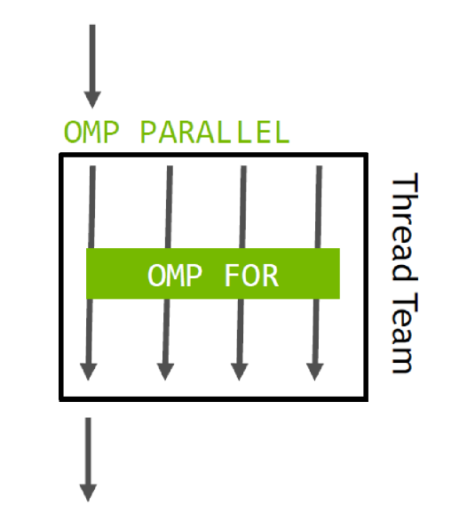
OpenMP GPU Directives
#pragma omp for
Divide workshare
Divide workshare across thread teams
/// Create team of threads
#pragma omp parallel
{
/// Workshare loop across threads
#pragma omp for
for (i = 0; i < N; i++) {
c[i] = a[i] * b[i];
}
}

Slide 17
OpenMP GPU Directives
Host execution
#pragma omp target
Transfer execution to device
Transfer data to/from device
Device execution
#pragma omp target
{
for (i = 0; i < N; i++) {
c[i] = a[i] * b[i];
}
}
Host execution

Slide 18
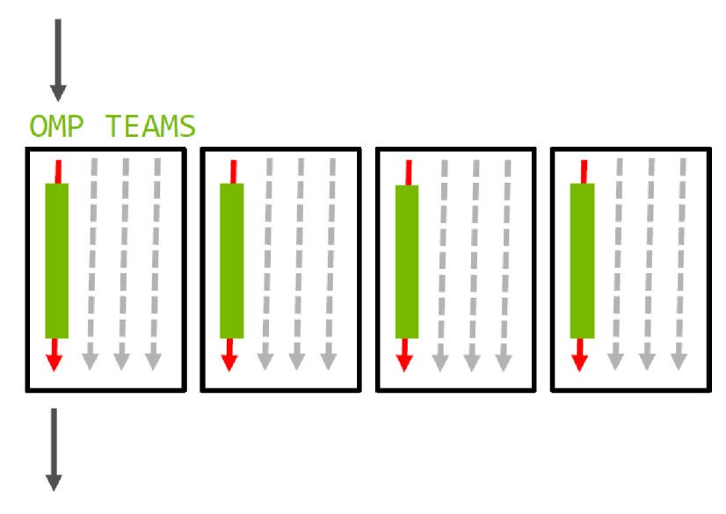
OpenMP GPU Directives
#pragma omp teams
Utilize GPU resources
Create one or more thread teams
Continue on team master threads
No synchronization between teams

Slide 19
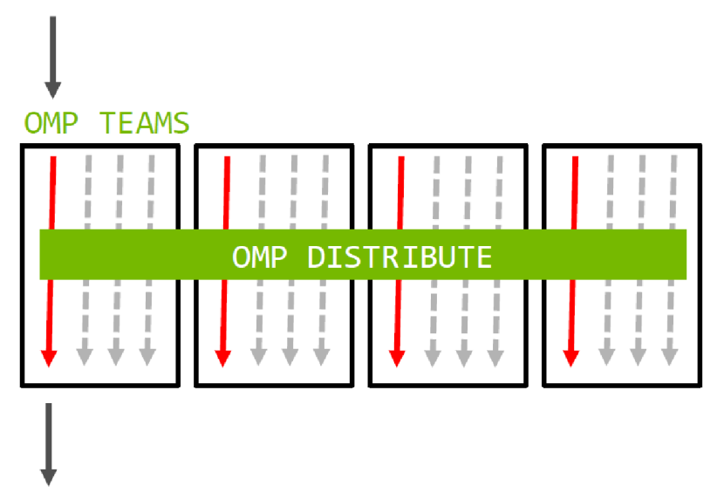
OpenMP GPU Directives
#pragma omp distribute
Distribute iterations to master threads of teams
Static distribution
No guaranteed execution order
Teams may not execute simultaneously

Slide 20
OpenMP GPU Directives
#pragma omp reduction(op:var)
Support map reductions
Team of threads perform local reductions
Master threads perform final reduction
Reduction operations are done on GPU
#pragma omp \
target teams distribute \
parallel for \
reduction(+:total)
for( i=0; i <N; i++)
{
total += array[i]
}

Slide 21
OpenMP GPU – Data Mapping
Data mapping controls:
How data is created on GPU ?
When data moves between CPU and GPU ?
What data is transferred ?
Direction of data movement
Lifetime of GPU data
Applied with:
#pragma omp target directive

Slide 22
OpenMP GPU – Data Mapping
map(tofrom: var)
Allocate GPU memory
Copy data from CPU to GPU at start
Copy data from GPU to CPU at end
Release GPU memory
map(to: var)
Allocate GPU memory
Copy data from CPU to GPU at start
Release GPU memory
No copy back at end

Slide 23
OpenMP GPU – Data Mapping
map(from: var)
Allocate GPU memory
No initial copy
Copy data from GPU to CPU at end
Release GPU memory

Slide 24
OpenMP GPU – Data Mapping
Create space for a, b, c
Copy a, b, c data at beginning
Copy back a, b, c data at end
Release space for a, b, c
#pragma omp target teams distribute parallel for \
map(tofrom: a[0:N], b[0:N], c[0:N])
{
for (i = 0; i < N; i++) {
c[i] = a[i] * b[i];
}
}

Slide 25
OpenMP GPU – Data Mapping
Create space for a, b, c
Copy a, b data at beginning
Copy back c data at end
Release space for a, b, c
#pragma omp target teams distribute parallel for \
map(to: a[0:N], b[0:N]) \
map(from: c[0:N])
{
for (i = 0; i < N; i++) {
c[i] = a[i] * b[i];
}
}

Slide 26
NVIDIA HPC SDK
Unified suite for GPU accelerated HPC development
Includes compilers, libraries, and developer tools
Supports CUDA, OpenACC, and OpenMP
NVIDIA HPC compiler
OpenMP target offload onto GPU
nvc – C code
nvc++ - C++ code
nvfortran - Fortran code

Slide 27
NVIDIA HPC SDK
/// OpenMP multicore CPU code
#pragma omp target teams distribute parallel for
for( i=0; i <N; i++)
{
c[i] = a[i] + b[i]
}
/// nvc++ -mp=multicore main.c
-mp
Compiler switch to enable OpenMP directives and pragmas
gpu
OpenMP directives are compiled for GPU execution and multicore CPU as fallback
multicore
OpenMP directives are compiled for multicore CPU execution only
/// OpenMP GPU code
#pragma omp target teams distribute parallel for
for( i=0; i <N; i++)
{
c[i] = a[i] + b[i]
}
/// nvc++ -mp=gpu main.c

Slide 28
OpenMP GPU – Vector Addition
#include <stdio.h>
#include <stdlib.h>
#include <math.h>
#include <omp.h>

Slide 29
OpenMP GPU – Vector Addition
int main( int argc, char* argv[] )
{
// Size of vectors
int n = 10000;
// Input vectors
double * a;
double * b;
// Output vector
double * c;

Slide 30
OpenMP GPU – Vector Addition
// Size, in bytes, of each vector
size_t bytes = n*sizeof(double);
// Allocate memory for each vector
a = (double*)malloc(bytes);
b = (double*)malloc(bytes);
c = (double*)malloc(bytes);

Slide 31
OpenMP GPU – Vector Addition
// Initialize content of input vectors,
// vector a[i] = sin(i)^2
// vector b[i] = cos(i)^2
int i;
for(i=0; i<n; i++) {
a[i] = sin(i)*sin(i);
b[i] = cos(i)*cos(i);
}

Slide 32
OpenMP GPU – Vector Addition
// Sum component wise vector a and vector b
// Save result into vector c
#pragma omp target teams distribute parallel for \
map(to: a[0:N], b[0:N]) \
map(from: c[0:N])
for(i=0; i<n; i++) {
c[i] = a[i] + b[i];
}

Slide 33
OpenMP GPU – Vector Addition
// Sum up vector c
// Print result divided by n
// This should equal 1 within error
double sum = 0.0;
for(i=0; i<n; i++) {
sum += c[i];
}
sum = sum/n;
printf(“final result: %f\n”, sum);

Slide 34
OpenMP GPU – Vector Addition
// Release memory
free(a);
free(b);
free(c);
return(0);
}

Slide 35
Questions?
Thank you

